Slide 1
Customer Success
Using
Deep Learning

Slide 2
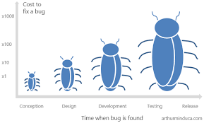
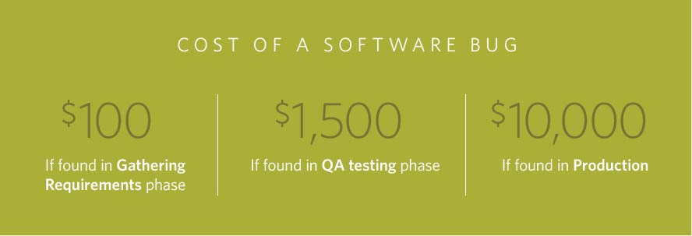
Motivation - Prior State of the Art
The Systems Sciences Institute at IBM has reported that “the cost to fix an error found after product release was four to five times as much as one uncovered during design, and up to 100 times more than one identified in the maintenance phase.”
A 2003 study commissioned by the Department of Commerce’s National Institute of Standards and Technology found that software bugs cost the US economy $59.5 billion annually.

Slide 3
Prediction of Potential Customer Issue
Business Problem: To identify or predict an internally found defect that has a potential to be reported as a customer issue and the lead time before which it can get converted to a customer found defect.
Business value: By proactively identifying the potential Customer issues,
We can save the cost of quality
Customer Retention
Quality
Business solution: A defect’s lifecycle and when and how an internally found defect became a CFD historically is analyzed and modeled to come up with classifying a defect as potential CFD and the lead time for it to become a potential CFD.
Notes:
New ELT since July 2015.
Renewed Focus on Quality
Our commitment in terms of quality and customer focus has always been part of Cisco. Over the years, the breadth of our product and importance of the network has increased. About a year ago, we found ourselves in a place we really didn’t want to be in terms of quality. Since Chuck took reigns as CEO, we needed to do a big transformation in the overall business model. Chuck asked Rebecca if she could specifically get involved in this transformation The conversation has moved from quality in a very traditional sense to that of a foundational quality which has to be built into every process we do, including engineering. What we want at the end of the day is the promise of a whole architecture and the needs of customers being met at a completely different level. It is core to how we will transform the entire company.

Slide 4
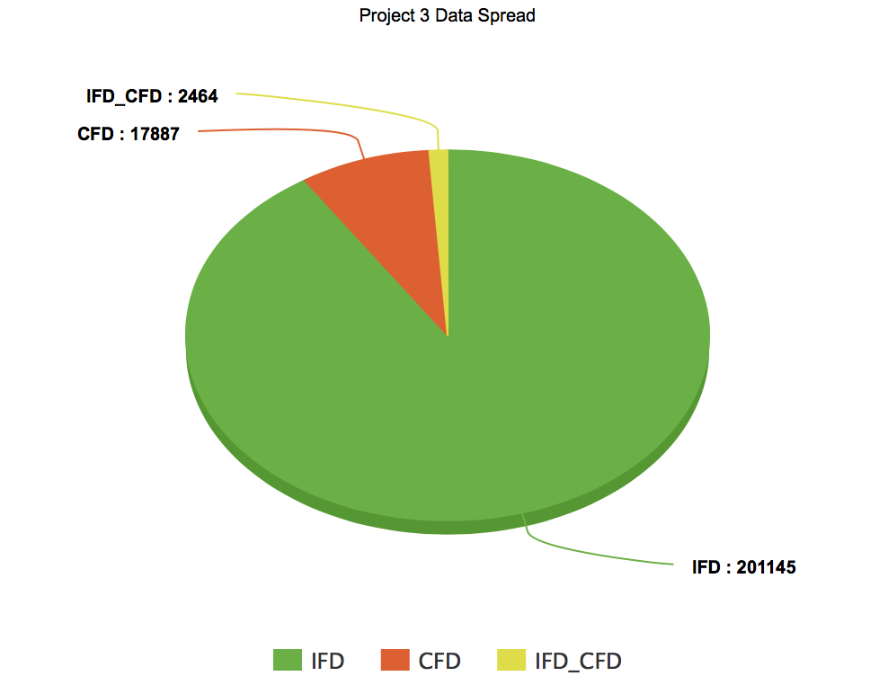
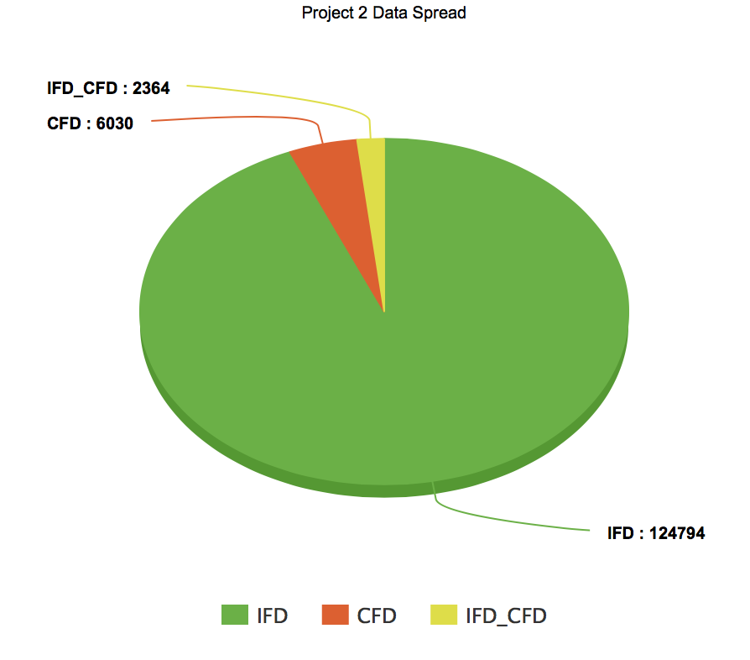
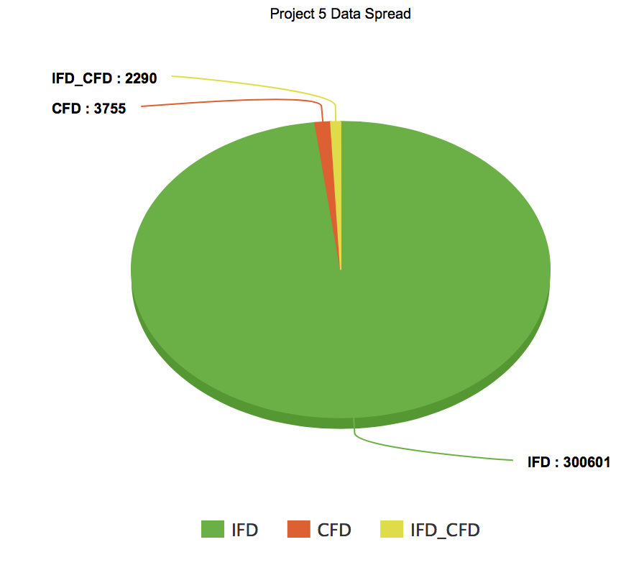
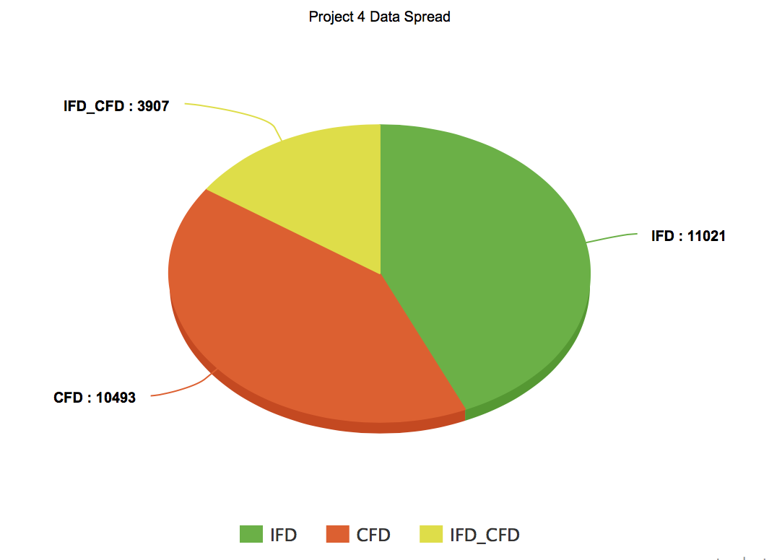
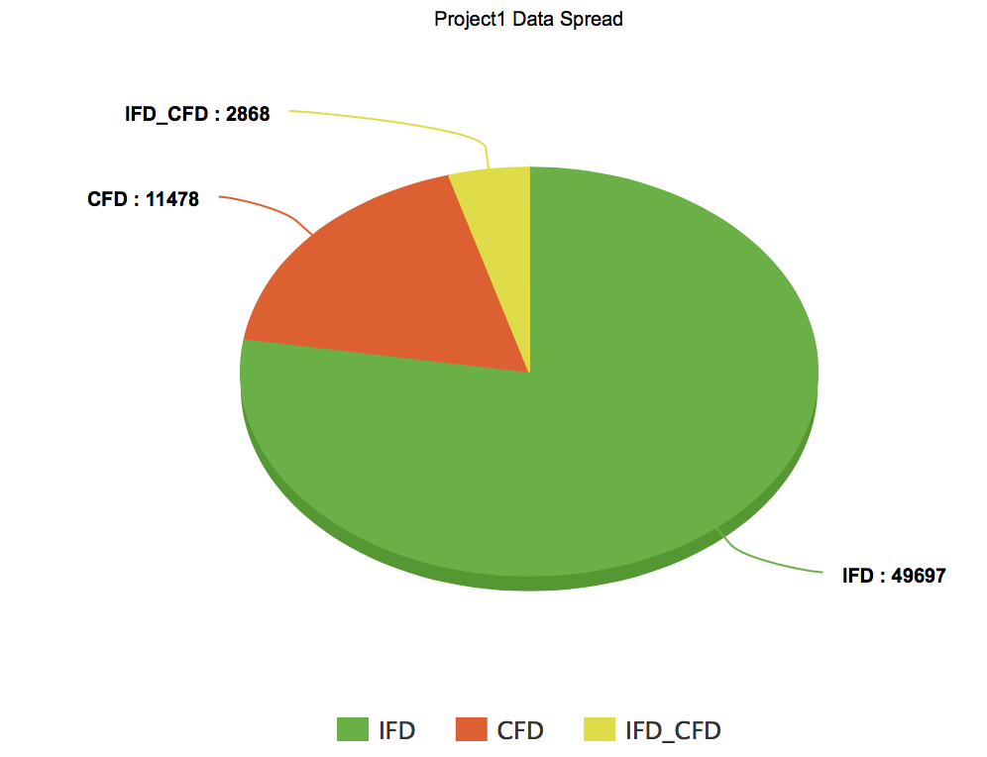
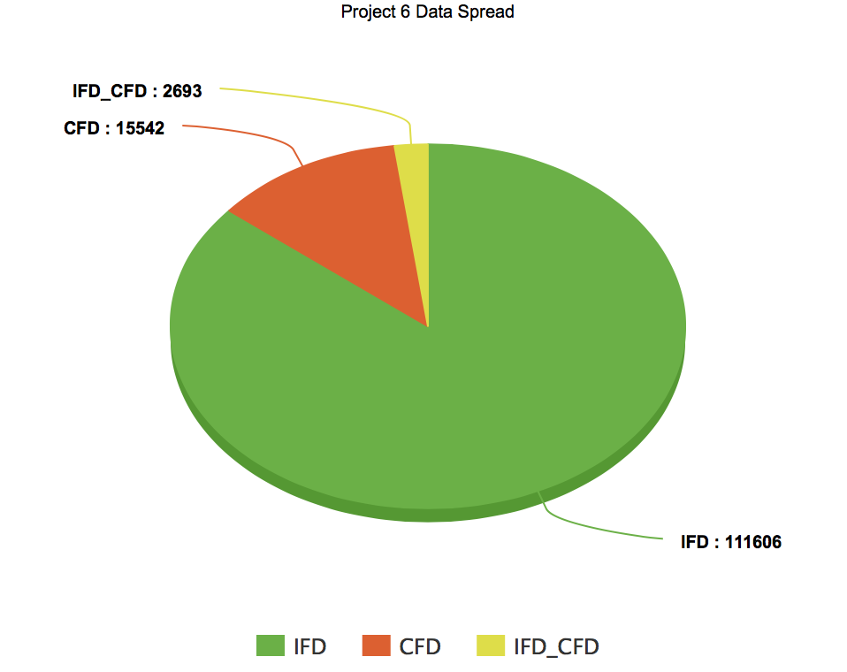
Datasets
Project 1
Project 2
Project 3
Data comprises of
Continuous features
Categorical features
Text descriptions
Project 4
Project 5
Project 6
Overall
Total Bugs ~ 20 million, 7% were customer reported issues. 1% were escaped issues which could have been resolved before the customer reported them.
Notes:
New ELT since July 2015.
Renewed Focus on Quality
Our commitment in terms of quality and customer focus has always been part of Cisco. Over the years, the breadth of our product and importance of the network has increased. About a year ago, we found ourselves in a place we really didn’t want to be in terms of quality. Since Chuck took reigns as CEO, we needed to do a big transformation in the overall business model. Chuck asked Rebecca if she could specifically get involved in this transformation The conversation has moved from quality in a very traditional sense to that of a foundational quality which has to be built into every process we do, including engineering. What we want at the end of the day is the promise of a whole architecture and the needs of customers being met at a completely different level. It is core to how we will transform the entire company.

Slide 5
Feature importance and data pre-processing
Missing values have been imputed using XGBoost algorithm.
The missing attributes are transformed into a matrix and XGBoost captures the trends in missing values and handles them internally.
The redundant features are removed using correlation.
Feature importance is performed to determine the important attributes, using random forest, univariate and bivariate selection.
The defect descriptions are preprocessed to remove email ids, most common words, stop words, special characters and then lemmatize the words.

Slide 6
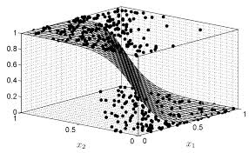
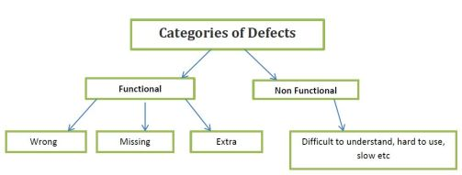
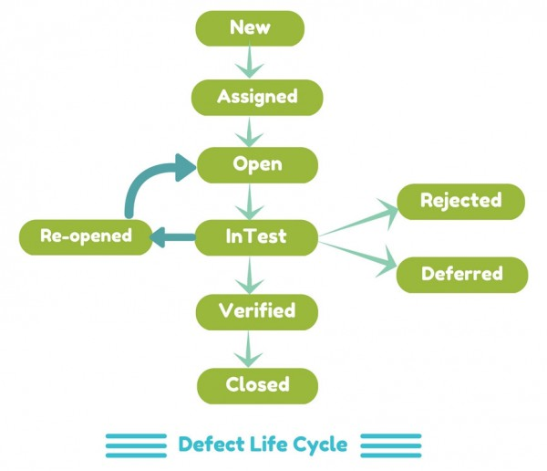
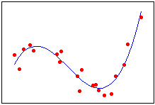
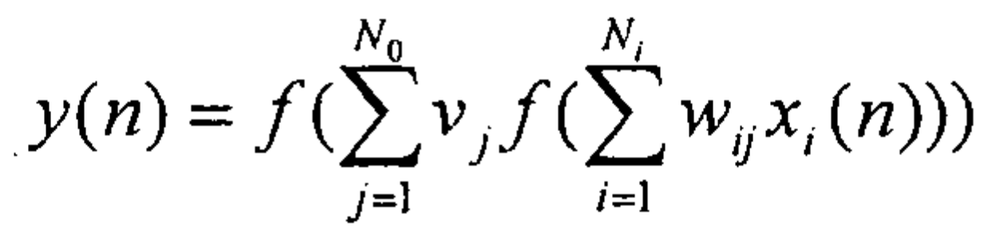
Deep Learning Algorithm
Input
Model
Output
Potential CFD ?
Defect Attributes
Classification
Yes
No
Defect Life Cycle Changes
Deep Neural Network Regression
Lead Time
Output from Classification Model
Notes:
New ELT since July 2015.
Renewed Focus on Quality
Our commitment in terms of quality and customer focus has always been part of Cisco. Over the years, the breadth of our product and importance of the network has increased. About a year ago, we found ourselves in a place we really didn’t want to be in terms of quality. Since Chuck took reigns as CEO, we needed to do a big transformation in the overall business model. Chuck asked Rebecca if she could specifically get involved in this transformation The conversation has moved from quality in a very traditional sense to that of a foundational quality which has to be built into every process we do, including engineering. What we want at the end of the day is the promise of a whole architecture and the needs of customers being met at a completely different level. It is core to how we will transform the entire company.

Slide 7
SMOTE Technique
To deal with the major challenge, data imbalance, synthetic minority over sampling technique is used.
This technique generates synthetic data for minority class so that the minority and majority class labels are balanced.
This generation of synthetic data is using K- nearest neighbors.
The synthetic data generated needs to have high similarity with minority class data points and high proximity from majority class data points.
This technique also avoids the problem of overfitting because a simple over sampling replicates the duplicates of minority class.
There is no loss of information as well, as the majority class is not under sampled.
Notes:
Explain what is minority class and majority class.
Explain what are the other techniques before explaining this technique.
Renewed Focus on Quality
Our commitment in terms of quality and customer focus has always been part of Cisco. Over the years, the breadth of our product and importance of the network has increased. About a year ago, we found ourselves in a place we really didn’t want to be in terms of quality. Since Chuck took reigns as CEO, we needed to do a big transformation in the overall business model. Chuck asked Rebecca if she could specifically get involved in this transformation The conversation has moved from quality in a very traditional sense to that of a foundational quality which has to be built into every process we do, including engineering. What we want at the end of the day is the promise of a whole architecture and the needs of customers being met at a completely different level. It is core to how we will transform the entire company.

Slide 8
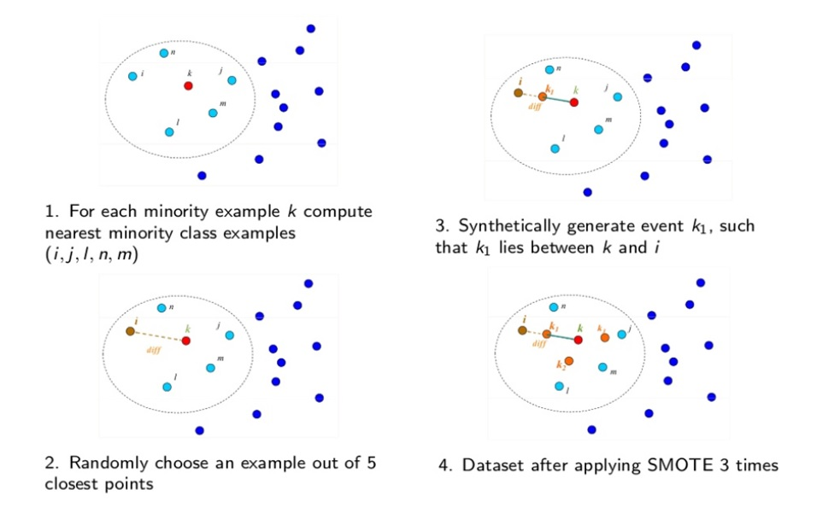
SMOTE explained
Image source: Google

Slide 9
Text classification using CNN and LSTM
Defect descriptions including chat conversations with customer, email attachments are used for prediction
The textual data is fed to the Convolutional Neural Network to capture the invariant keywords and intent extraction.
These intent and keyword mappings are then fed to a Recurrent Neural Network (LSTM) that captures the long term dependencies in the sentences.
The text classification model outputs a probability indicating the propensity of a defect to become a customer issue.

Slide 10
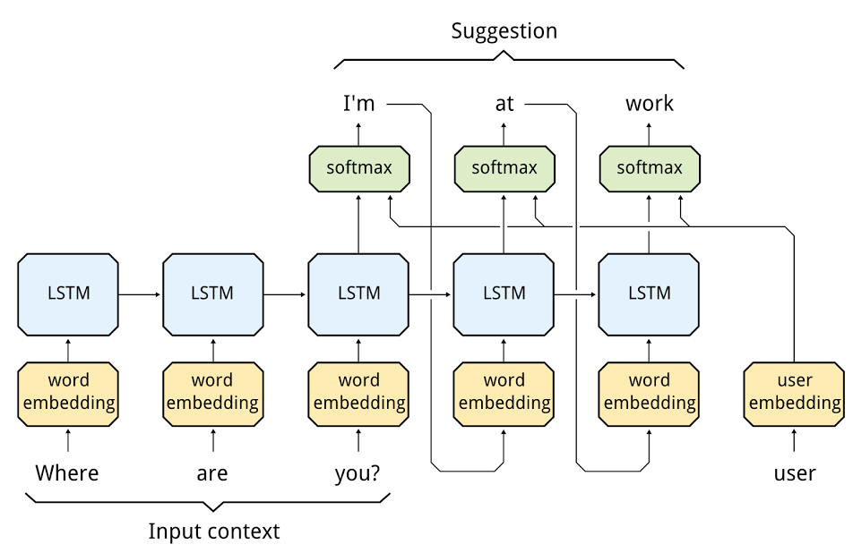
LSTM explained
Image source: Google

Slide 11
Classification using Boosting algorithm
XGBoost is an advanced implementation of gradient boosting algorithm.
The structured data consisting of both continuous and categorical attributes are used for classification.
This distributed boosting method is hyper-tuned to convert weak learners to strong learners.
In XGBoost, the trees are grown using information from the previously grown tree.
Gradient descent is used to minimize the sum of squares loss function

Slide 12
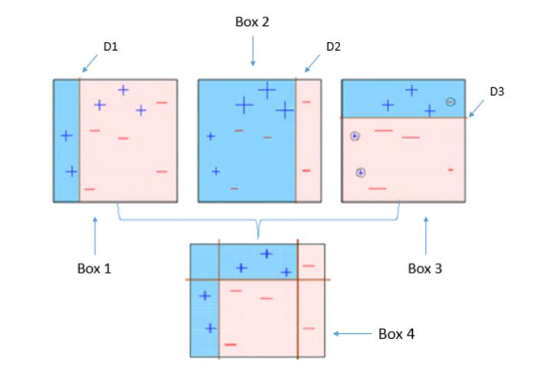
XGBoost explained
Image source: Google

Slide 13
Ensemble – prediction of customer issue
Stacking ensemble method is used to boost predictive accuracy by blending the predictions from both textual data and structured data.
Feature-Weighted Linear Stacking technique is used.
It uses linear combination of both the model results to make a prediction.
The coefficients in linear combination are determined using meta-data from the training data set.

Slide 14
Prediction of lead time for customer issue
Lead time predictions model is run on the defects with have the propensity to become customer issue.
A 3-layered Deep Neural Network is built in TensorFlow to predict the number of days it takes a customer to face this issue.
The model architecture is computed graphically and parameterized to compute optimal results.
Mean sum of squared error loss function is used with ADAM optimizer for back propagation.

Slide 15
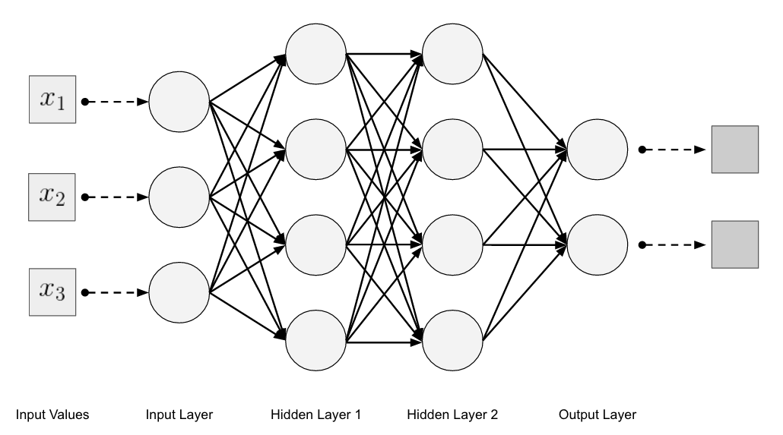
Deep Neural Network architecture
Image source: Google

Slide 16
Experimental Results
The model is tested across various Business Units with 21 projects consisting of more than 10M data.
Text data classification
Accuracy – 80%, Precision – 80.3%, Recall – 82.1%
Structured data classification
Accuracy – 83%, Precision – 81%, Recall – 78.6%
Ensemble
Accuracy – 95%, Precision – 82%, Recall – 83%
Prediction of lead time
The lead time prediction is accurate with a variance of 15 days.
Notes:
New ELT since July 2015.
Renewed Focus on Quality
Our commitment in terms of quality and customer focus has always been part of Cisco. Over the years, the breadth of our product and importance of the network has increased. About a year ago, we found ourselves in a place we really didn’t want to be in terms of quality. Since Chuck took reigns as CEO, we needed to do a big transformation in the overall business model. Chuck asked Rebecca if she could specifically get involved in this transformation The conversation has moved from quality in a very traditional sense to that of a foundational quality which has to be built into every process we do, including engineering. What we want at the end of the day is the promise of a whole architecture and the needs of customers being met at a completely different level. It is core to how we will transform the entire company.

